Slide 1
DevOps Engineering

Slide 2
What is devOps Engineering?
Definition. DevOps (a portmanteau of “development” and “operations”) is the combination of practices and tools designed to increase an organization's ability to deliver applications and services faster than traditional software development processes.
Introduces processes, tools, and methodologies to balance needs throughout the software development life cycle, from coding and deployment, to maintenance and updates.
Maybe you want to shift your career to DevOps, or train yourself to drive adoption within your company.
Notes:
Drive adoptions means movement which is all about removing barriers enabling better collaboration between software developers and operation engineers and which focuses on automation as the primary way to make software delivery

Slide 3
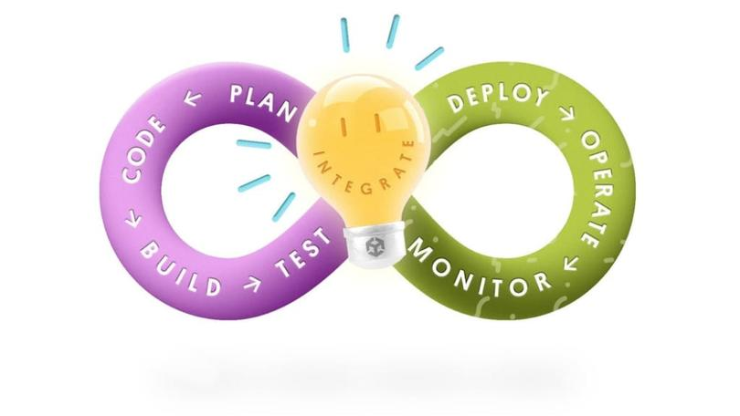
Devops

Slide 4
Benefits Of DevOps 1. speed
Move at high velocity so you can innovate for customers faster, adapt to changing markets better, and grow more efficient at driving business results.
The DevOps model enables your developers and operations teams to achieve these results. For example, microservices and continuous delivery let teams take ownership of services and then release updates to them quicker.

Slide 5
Continuous Delivery
Continuous delivery is a software development practice where code changes are automatically built, tested, and prepared for a release to production.
It expands upon continuous integration by deploying all code changes to a testing environment and/or a production environment after the build stage.
When continuous delivery is implemented properly, developers will always have a deployment-ready build artifact that has passed through a standardized test process.

Slide 6
Microservices
The microservices architecture is a design approach to build a single application as a set of small services.
Each service runs in its own process and communicates with other services through a well-defined interface using a lightweight mechanism, typically an HTTP-based application programming interface (API).
Microservices are built around business capabilities; each service is scoped to a single purpose.
You can use different frameworks or programming languages to write microservices and deploy them independently, as a single service, or as a group of services.

Slide 7
Continuous Integration
Continuous integration is a software development practice where developers regularly merge their code changes into a central repository, after which automated builds and tests are run.
The key goals of continuous integration are to find and address bugs quicker, improve software quality, and reduce the time it takes to validate and release new software updates.

Slide 8
2.Rapid Delivery
Increase the frequency and pace of releases so you can innovate and improve your product faster.
The quicker you can release new features and fix bugs, the faster you can respond to your customers’ needs and build competitive advantage.
Continuous integration and continuous delivery are practices that automate the software release process, from build to deploy.

Slide 9
3.Reliability
Ensure the quality of application updates and infrastructure changes so you can reliably deliver at a more rapid pace while maintaining a positive experience for end users.
Use practices like continuous integration and continuous delivery to test that each change is functional and safe. Monitoring and logging practices help you stay informed of performance in real-time.

Slide 10
Configuration Management
Developers and system administrators use code to automate operating system and host configuration, operational tasks, and more.
The use of code makes configuration changes repeatable and standardized. It frees developers and systems administrators from manually configuring operating systems, system applications, or server software.

Slide 11
Policy as Code
With infrastructure and its configuration codified with the cloud, organizations can monitor and enforce compliance dynamically and at scale. Infrastructure that is described by code can thus be tracked, validated, and reconfigured in an automated way.
This makes it easier for organizations to govern changes over resources and ensure that security measures are properly enforced in a distributed manner (e.g. information security or compliance with PCI-DSS or HIPAA).
This allows teams within an organization to move at higher velocity since non-compliant resources can be automatically flagged for further investigation or even automatically brought back into compliance.

Slide 12
Monitoring and Logging
Organizations monitor metrics and logs to see how application and infrastructure performance impacts the experience of their product’s end user.
By capturing, categorizing, and then analyzing data and logs generated by applications and infrastructure, organizations understand how changes or updates impact users, shedding insights into the root causes of problems or unexpected changes.
Active monitoring becomes increasingly important as services must be available 24/7 and as application and infrastructure update frequency increases.
Creating alerts or performing real-time analysis of this data also helps organizations more proactively monitor their services.

Slide 13
Communication and Collaboration
Increased communication and collaboration in an organization is one of the key cultural aspects of DevOps.
The use of DevOps tooling and automation of the software delivery process establishes collaboration by physically bringing together the workflows and responsibilities of development and operations.
Building on top of that, these teams set strong cultural norms around information sharing and facilitating communication through the use of chat applications, issue or project tracking systems, and wikis.
This helps speed up communication across developers, operations, and even other teams like marketing or sales, allowing all parts of the organization to align more closely on goals and projects.

Slide 14
4.SCALE
Operate and manage your infrastructure and development processes at scale.
Automation and consistency help you manage complex or changing systems efficiently and with reduced risk.
For example, infrastructure as code helps you manage your development, testing, and production environments in a repeatable and more efficient manner.

Slide 15
Infrastructure as Code
Infrastructure as code is a practice in which infrastructure is provisioned and managed using code and software development techniques, such as version control and continuous integration.
The cloud’s API-driven model enables developers and system administrators to interact with infrastructure programmatically, and at scale, instead of needing to manually set up and configure resources.
Thus, engineers can interface with infrastructure using code-based tools and treat infrastructure in a manner similar to how they treat application code.
Because they are defined by code, infrastructure and servers can quickly be deployed using standardized patterns, updated with the latest patches and versions, or duplicated in repeatable ways.

Slide 16
Improved Collaboration
Build more effective teams under a DevOps cultural model, which emphasizes values such as ownership and accountability.
Developers and operations teams collaborate closely, share many responsibilities, and combine their workflows.
This reduces inefficiencies and saves time (e.g. reduced handover periods between developers and operations, writing code that takes into account the environment in which it is run).

Slide 17
5.Security
Move quickly while retaining control and preserving compliance.
You can adopt a DevOps model without sacrificing security by using automated compliance policies, fine-grained controls, and configuration management techniques.
For example, using infrastructure as code and policy as code, you can define and then track compliance at scale.

Slide 18
DevOps Tools
The DevOps model relies on effective tooling to help teams rapidly and reliably deploy and innovate for their customers.
These tools automate manual tasks, help teams manage complex environments at scale, and keep engineers in control of the high velocity that is enabled by DevOps.
AWS provides services that are designed for DevOps and that are built first for use with the AWS cloud.
These services help you use the DevOps practices described above.

